Slide 1
Efficient dual numbers reverse automatic differentiation by well-known program transformations
Paper by Tom Smeding and Matthijs Vákár
Presentation by Simon van Hus

Slide 2
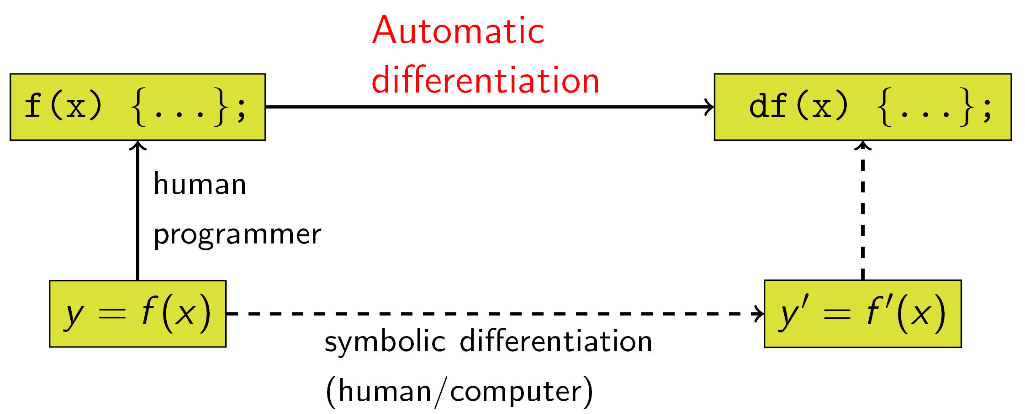
Automatic Differentiation
Manual Differentiation
Symbolic Differentiation
Numeric Differentiation
Automatic Differentiation

Slide 3
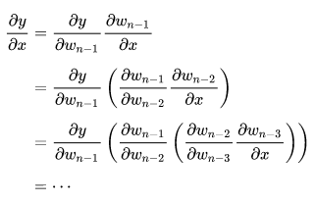
Automatic Differentiation
Manual Differentiation
Symbolic Differentiation
Numeric Differentiation
Automatic Differentiation
Forward Mode

Slide 4
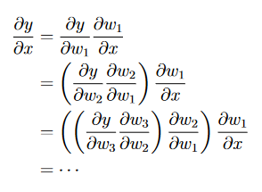
Automatic Differentiation
Manual Differentiation
Symbolic Differentiation
Numeric Differentiation
Automatic Differentiation
Forward Mode
Reverse Mode

Slide 5
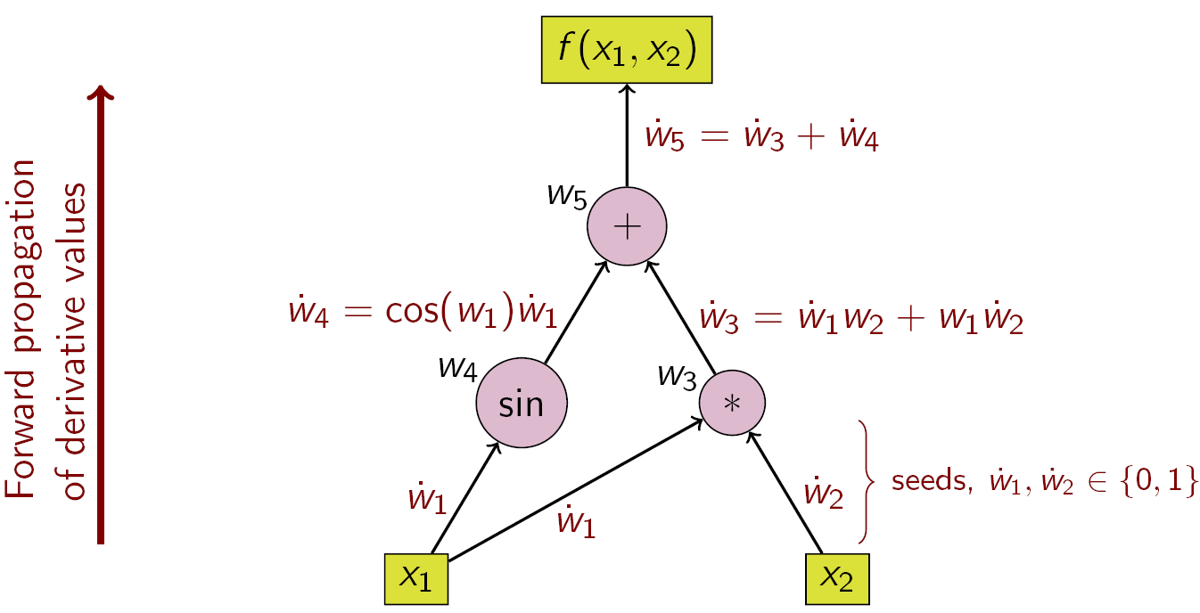
Dual Numbers
Tangents
Forward Mode

Slide 6
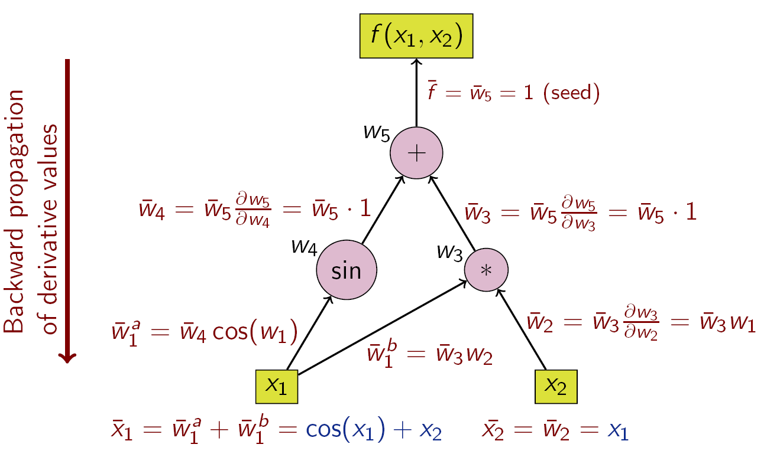
Dual Numbers
Tangents
Forward Mode
Reverse Mode
Adjoints

Slide 7
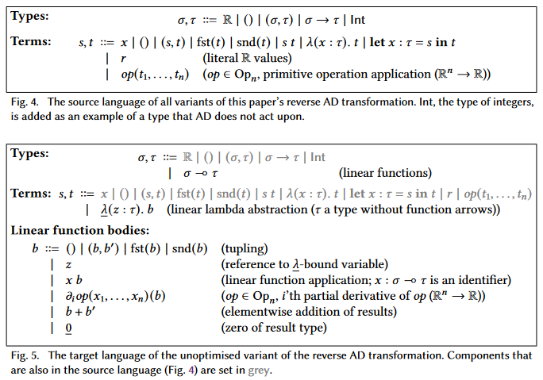
Naïve Reverse AD
Source and Target Languages

Slide 8
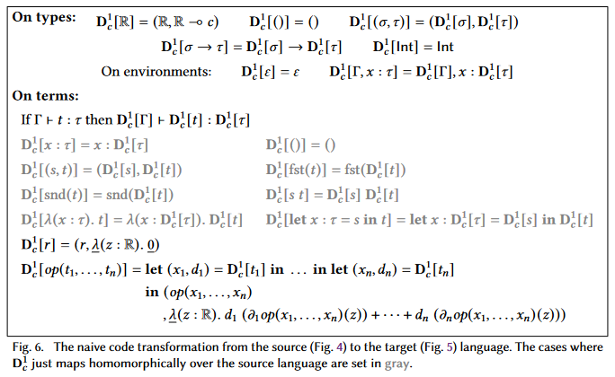
Naïve Reverse AD
Source and Target Languages
Source Code Transformation

